Slide 1
Data Analytics
Student Habits Performance &
Politician text analysis
Assoumany Yeningna Orlane Kone
Nunekpeku Kimberly Elorm

Slide 2
CONTENT:
PART ONE: STUDENT HABIT PERFORMANCE
Introduction
Data Preparation
Exploratory Data Analysis
Statistical Analysis
Predictive Modeling
Clustering
Recommendations
Limitations and Future Work
Conclusion
An Appendix: Code and Additional Outputs
PART TWO: POLITICIAN TEXT ANALYSIS(HENRY KONAN BEDIE)
Introduction & Data Preparation
Cleaning the text
Tokenization
Stopwords Identification and removal
Stemming and lemmatization
word frequencies and TF-IDF
Sentiment analysis
Conclusion
An Appendix: Code and Additional Outputs

Slide 3
Introduction
This report explores how everyday student habits influence academic performance. We analyzed data from 1,000 students to understand the real impact of sleep, study time, screen usage, diet, exercise, attendance, mental health, and other daily choices on their final exam scores.
The analysis follows a complete pipeline: • Data preparation and feature engineering • Exploratory data analysis • Statistical testing • Linear regression modeling • K-means clustering • Practical recommendations for students and institutions

Slide 4
2. Data Overview & Preparation
The dataset contains detailed information about 1,000 students across 16 different variables, including age, gender, daily study hours, social media and Netflix time, part-time job status, attendance percentage, sleep hours, diet quality, exercise frequency, parental education level, internet quality, mental health rating, extracurricular participation, and final exam score.
We found only one issue: 91 missing values in the parental education column (9.1 %). These were handled so the final dataset has zero missing values and no duplicate rows. We dropped the student ID column because it was not useful for analysis.

Slide 5
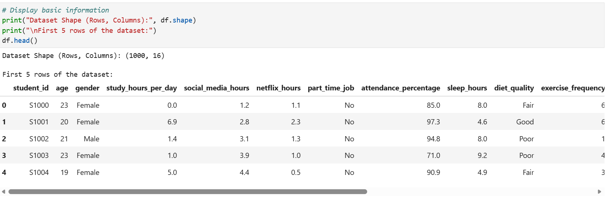
Feature Engineering Highlights We created several powerful new variables, such as:
Total distraction hours (social media + Netflix)
Study efficiency (study hours divided by sleep hours)
Productive hours (study hours multiplied by attendance)
Wellness score (combined diet, exercise, and sleep)
These new features help us see the combined effect of habits more clearly.

Slide 6
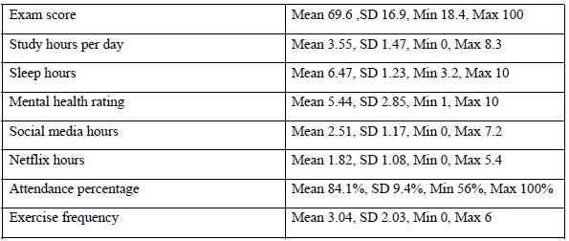
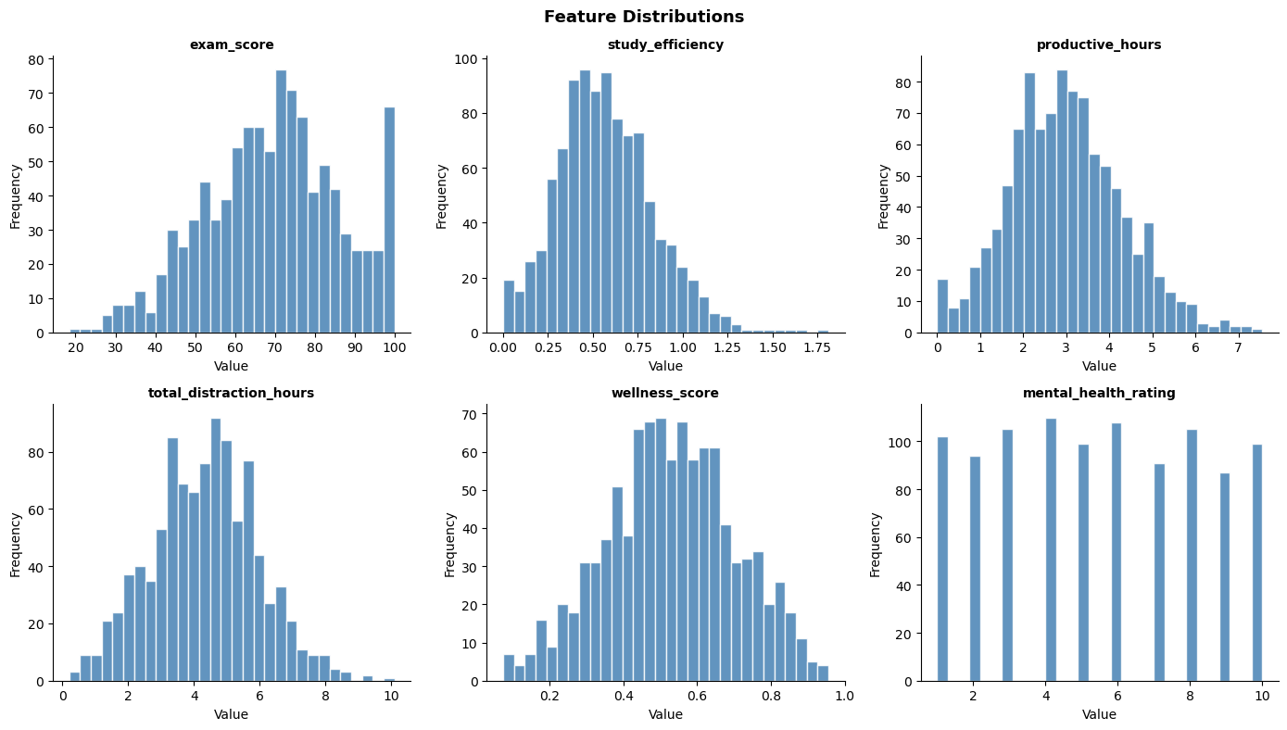
3. Exploratory Data Analysis Key Variable Overview
Students in the dataset show a wide range of habits and results. On average, students:
• Scored 69.6 out of 100 on their exam
• Studied 3.55 hours per day
• Slept 6.47 hours per night (below the recommended 8 hours)
• Spent 2.51 hours on social media and 1.82 hours on Netflix daily
• Attended 84.1 % of classes
• Rated their mental health 5.44 out of 10
These numbers reveal that many students are balancing heavy screen time and relatively short sleep with their studies.

Slide 7
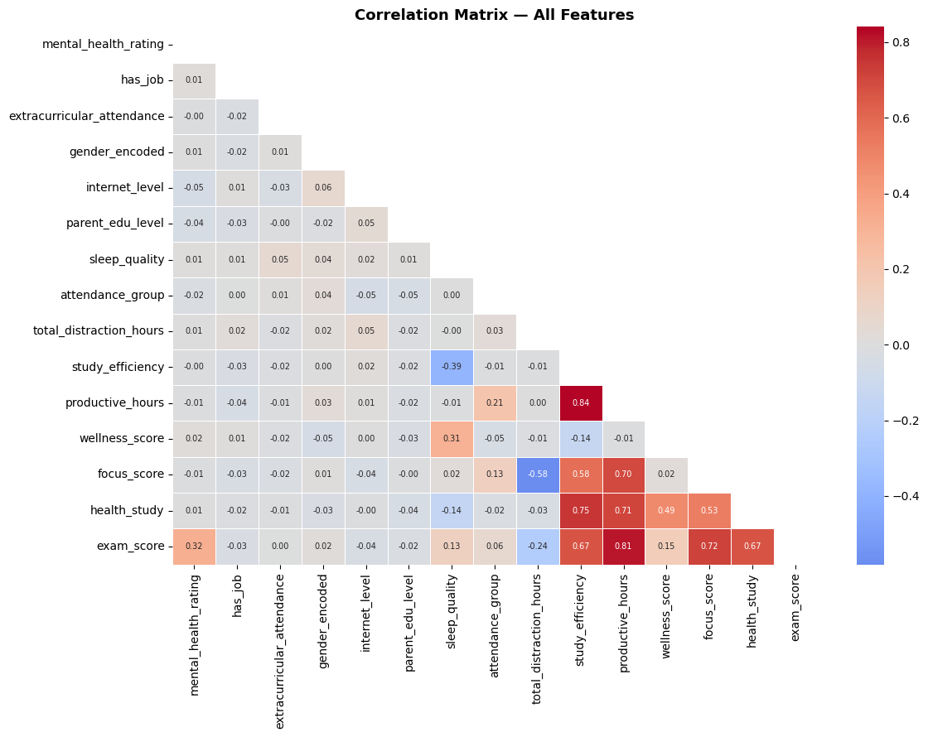

Slide 8
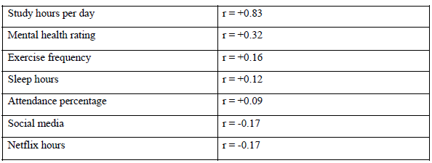
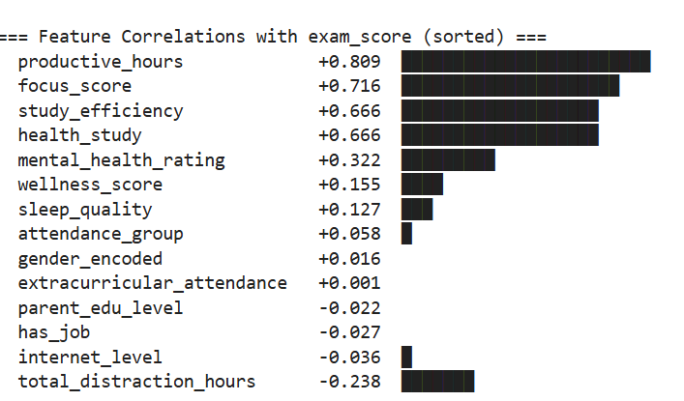
3.2 Correlation Analysis What Really Drives Exam Scores?
The strongest relationship we found is between daily study hours and exam performance – they are very strongly connected. Mental health rating also shows a clear positive link with better scores. Exercise frequency and sleep hours have milder positive connections.
On the other hand, more time spent on social media and Netflix is clearly linked to lower exam scores.
This is why we created combined features such as study efficiency, productive hours, total distraction hours, and wellness score – they turn these individual habits into even stronger predictors of success.

Slide 9
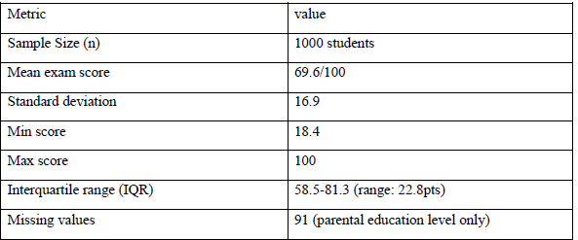
4. Statistical Analysis Main Insights from the Data
Study time stands out as the single most powerful factor influencing exam performance. Mental health and overall wellness also play important independent roles in helping students succeed. Screen-based distractions (social media and Netflix) have a noticeable negative effect on results.
Overall, the 1,000 students achieved an average exam score of 69.6, with scores ranging from 18.4 to a perfect 100. The typical spread shows most students scored between roughly 58 and 81.

Slide 10
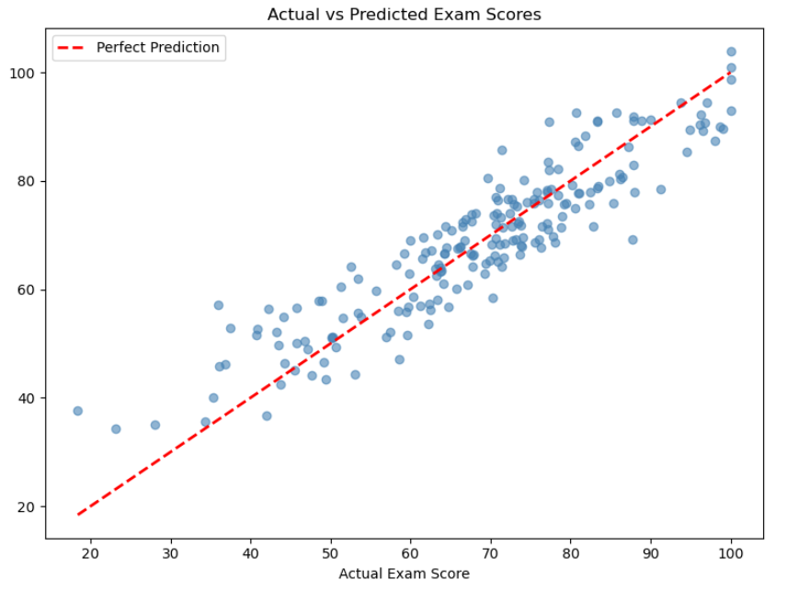
5. Predictive Modeling Linear Regression Results
We built a linear regression model using the engineered features (study efficiency, productive hours, wellness score, mental health, attendance group, sleep quality, total distraction hours, and more).
The model performed very well: • It explains 84 % of the differences in exam scores (R² = 0.8402) • On average, predictions are only about 6 points off the actual score (RMSE = 6)
The Actual vs Predicted plot shows the model works reliably across the full score range, with the strongest accuracy for average students (scores between 50 and 85).

Slide 11
6. K-means Clustering Student Behavior Profiles
Using the key engineered features, we applied K-means clustering and identified four distinct student groups.
The Four Profiles (in simple terms):
• Cluster 0 – Struggling Students: Low study time, high distraction hours, lower scores
• Cluster 1 – Average Students: Moderate habits and moderate performance
• Cluster 2 – High-Discipline Students: Strong study habits, low distractions, high scores
• Cluster 3 – Excellent Students: Very high study efficiency and top scores, even with some distractions
These clusters clearly show how different combinations of habits lead to different academic outcomes.

Slide 12
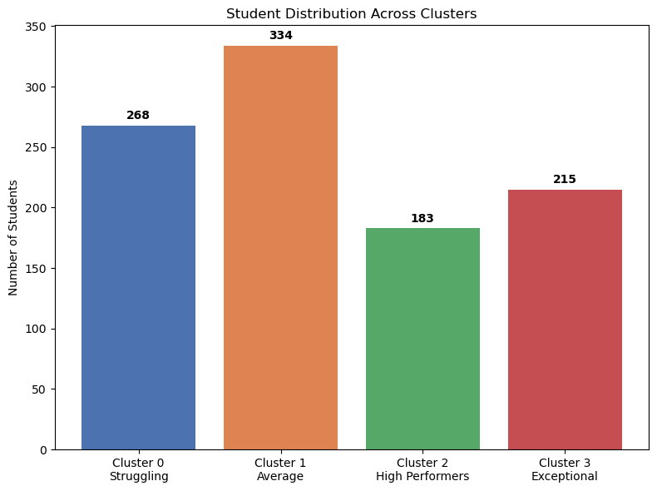
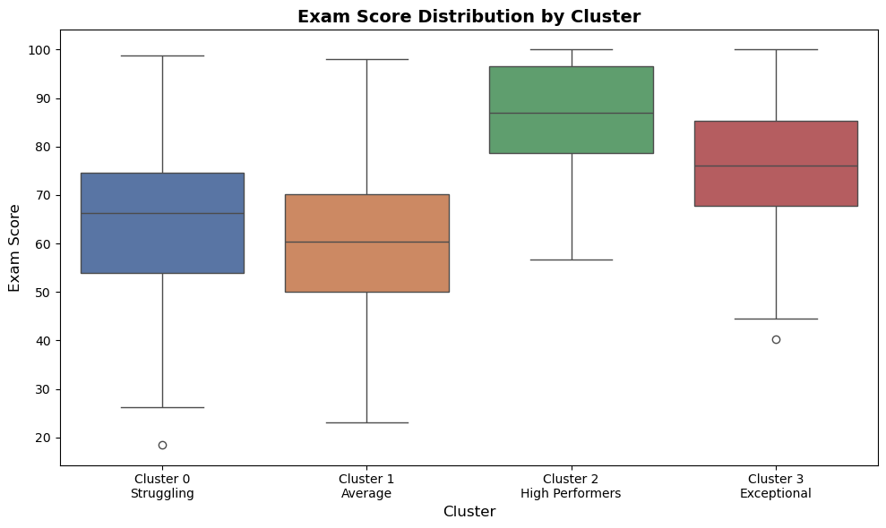

Slide 13
7. Recommendations Practical Actions for Students and Schools
Based on everything we discovered, here are clear, actionable suggestions:
• Make developing strong study habits the top priority – offer structured study programs and quiet study spaces.
• Actively support student mental health with regular wellness check-ins and easy access to counseling.
• Help students cut down on screen distractions through awareness campaigns and tools that block social media and Netflix during study time.
• Promote better sleep and physical activity – average sleep is only 6.47 hours, so run sleep education campaigns and encourage exercise.
• Tailor support to each student group: intensive help for struggling students, motivation workshops for average students, and advanced opportunities for high performers.

Slide 14
8. Limitations and Future Work
91 students had missing information about parental education level
We only had one overall exam score (not grades from multiple subjects)
No information about the specific school or country

Slide 15
9. Final Conclusion
Academic success is not just about being naturally smart – it is strongly shaped by everyday habits. Study time is the biggest driver, but mental health, wellness, and reduced distractions also matter a great deal. The four student profiles we found make it possible to give much more targeted and practical support instead of generic advice.

Slide 16
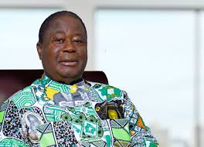
Part 2: Politician analysis Henry Konan Bedie

Slide 17
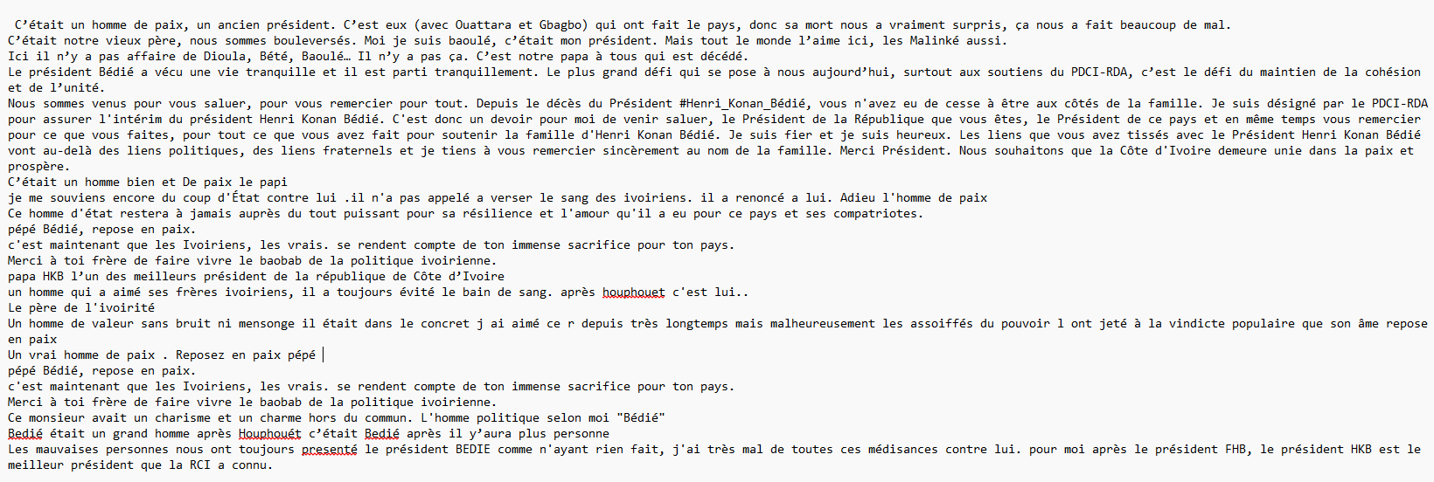
1. Introduction & Data Preparation
This section presents a Natural Language Processing analysis of a French tribute text about Henri Konan Bédié, former President of Côte d’Ivoire. The text is a single document of roughly 600 words that reads like a commemorative speech honoring his life and legacy.

Slide 18
2. Text Cleaning, Tokenization & Stopwords Preparing the Text for Analysis
We first cleaned the text by removing citation markers, special characters, and extra spaces, then converted everything to lowercase. Next, we split the text into individual words (tokenization), which gave us 544 meaningful words after removing punctuation. We then removed common French stopwords (words like “le”, “de”, “et”, “à”), which eliminated 44.3 % of the words and left us with the most important content words

Slide 19
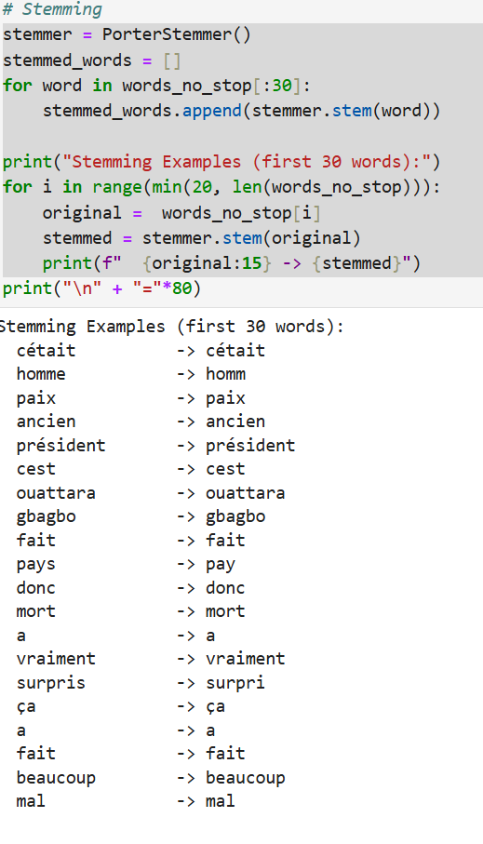
3. Stemming & Lemmatization Normalizing the Words
We applied stemming and lemmatization to reduce words to their root forms. Because the tools are mainly designed for English, the effect on this French text was limited. Most key terms (président, paix, Bédié, Ouattara, Gbagbo) stayed almost unchanged, but the step still helped clean up minor variations.

Slide 20
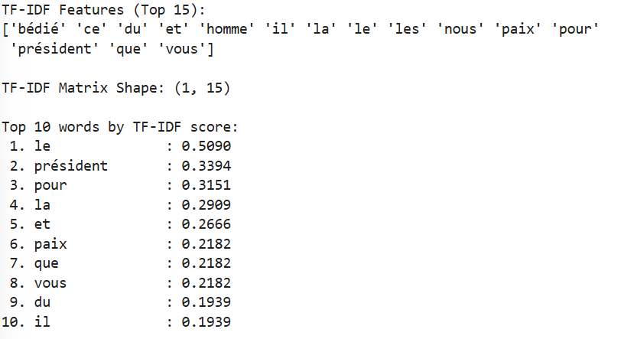
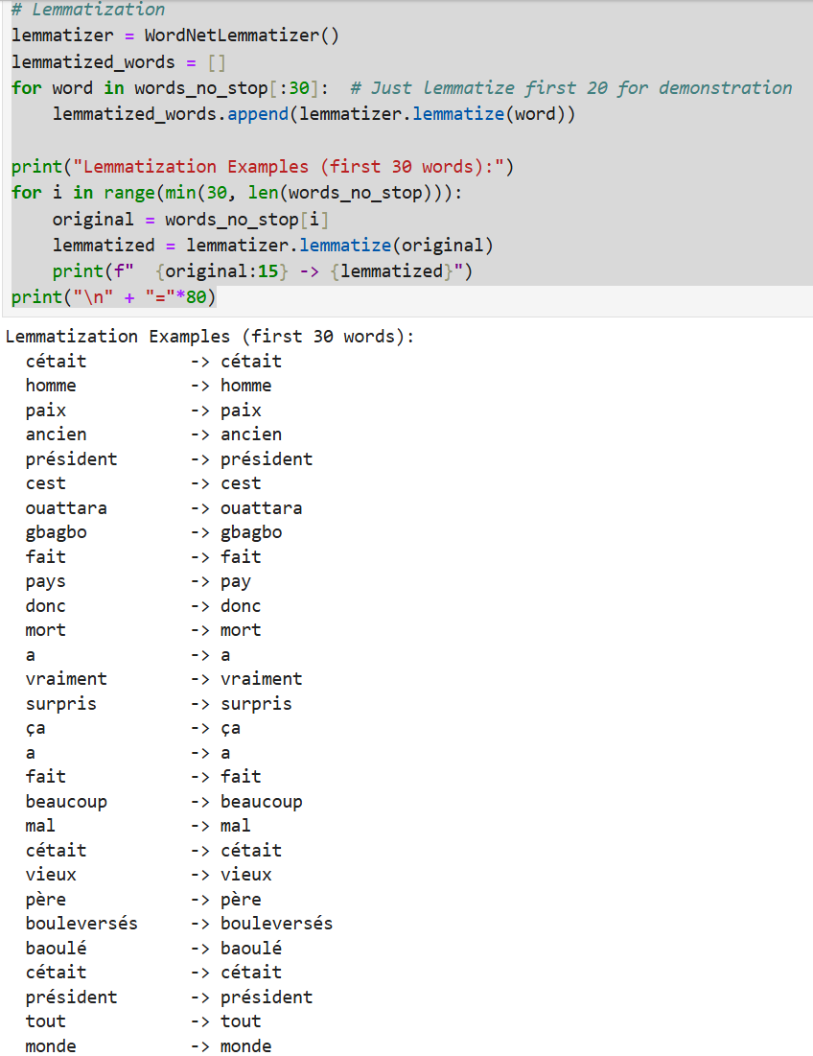
4. Word Frequencies & TF-IDF Most Important Words in the Speech
The most frequently used words clearly show the main themes of the text: “président” appears most often, followed by “paix” (peace), “homme” (man), “Bédié”, “pays” (country), and “ivoiriens” (Ivorian people).
The TF-IDF analysis confirms that words related to leadership, peace, national unity, and respect for Bédié’s legacy carry the strongest importance. A word cloud and bar chart of the top 20 words highlight “président”, “paix”, and “Bédié” as the dominant terms.

Slide 21
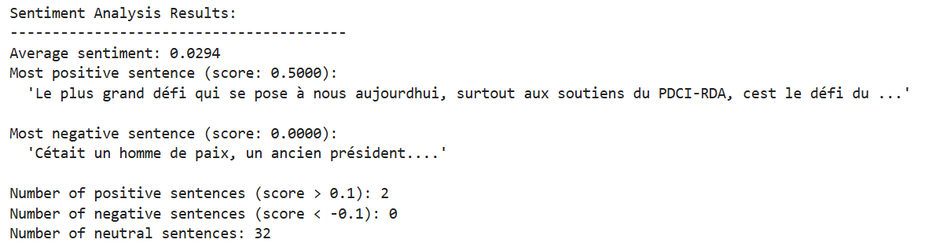
4. Sentiment Analysis Emotional Tone of the Text
We analyzed the sentiment of each sentence using TextBlob. The overall sentiment is slightly positive (average score 0.0294). Out of 34 sentences:
• 2 were positive
• 0 were negative
• 32 were neutral
The tone is calm, respectful, and dignified – exactly what you would expect in a commemorative speech. The speaker focuses on gratitude, hope, and reconciliation rather than sadness or criticism.

Slide 22
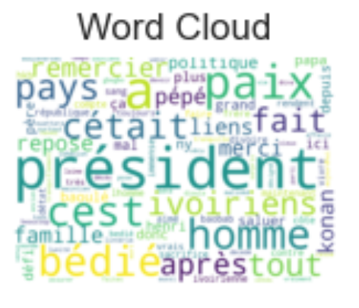
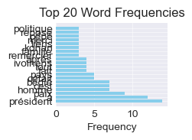
Overall Conclusion
This is a respectful tribute speech honoring Henri Konan Bédié’s role as president and his contribution to peace. The frequent emphasis on leadership, peace, and the Ivorian people shows the speaker’s desire to celebrate Bédié’s legacy while promoting national unity and reconciliation.

